Slide 1
CSE 110: Programming Language I
Matin Saad Abdullah
mabdullah@bracuniversity.net
UB 1222

Slide 2
Arithmetic operations
Operation Symbol in C
Addition +
Subtraction -
Multiplication *
Division /
Remainder %
In Mathematics In C
a+b a+b
A-b A-b
a × b a*b
a ÷ b a/g

Slide 3
Integer arithmetic
If the operands are integer, then integer arithmetic is performed to yield an integer. For example,
5+3 gives 8
5*3 gives 15
5-3 gives 2
In integer division, fractional part is deleted
5/4 gives 1
4/5 gives 0
-7/2 gives -3

Slide 4
Floating-point arithmetic
If the operands are floating-point, then floating-point arithmetic is performed to yield a floating-point value.
5.+3. yields 8.
5.*3. yields 15.
5.-3. yields 2.
Real division is similar to ordinary division
5./4. yields 1.25
4./5. yields 0.8
-7./2. yields -3.5

Slide 5
Arithmetic operations
Mixed mode operation
5.0-3 gives 2.
4./5 gives 0.8
4/5. gives 0.8
4*3. gives 12.
The remainder operator (%) returns the integer remainder of the result of dividing its first operand by its second. For example
the value of 7%2 is 1
299%100 is 99

Slide 6
Assignment statements
An assignment statement has the following form:
variable=expression;
Example:
px=2+3;
sal=5/2-(3*5/2)/2; ⇐ yes
a=b+c;
b=b+b+b;
b+c=a; ⇐ No
a+b=c+d;

Slide 7
Why Remainder
The number of hours, minutes, and seconds in a given number of seconds. For example, how many hours, minutes, and seconds are there in 10,000 seconds? First let us develop some basic identities:
  60 seconds = 1 minute
  60 minutes = 1 hour
This means that one hour has 60×60 seconds, or 3,600 seconds.
How many hours, minutes and seconds in 10000 seconds.

Slide 8
String Concatenation
Strings can be spliced together (a process known as concatenation) using the + operator.
The compiler and interpreter will automatically convert a primitive type into a human-readable string when required.

Slide 9
+ Operator is Overloaded
When both operands are numbers, + performs familiar arithmetic addition.
When one or both of its operands is a String, + converts the non-String operand to a String if necessary and then performs string concatenation.

Slide 10
Math Class
Very useful. Provides many methods in a pre-built class.
The following are available in the Math class
Trigonometry functions:
sin, cos, tan, acos, atan, asin

Slide 11
Exponent Methods
exp – raise e to a power
sqrt – returns the square root
pow – raise a number to a power
log – natural log of a number

Slide 12
Rounding in Math Class
ceil – round up to nearest integer
floor – round down to nearest integer

Slide 13
Helpful Math
random – Returns a random number greater than or equal to 0.0 and less than 1.0
abs – return absolute value of a number
min – return minimum of two numbers
max – return max of two numbers

Slide 14
Mathematical Library Functions
In Mathematics In Java
? Math.sqrt(x)
? Math.abs(y)
? Math.pow(x,y)
? Math.exp(x)
sinx Math.sin(x)
cosx Math.cos(x)
tany Math.tan(y)
? Math.log(x)
? Math.log10(y) where x and y are of type double.

Slide 15
Compound Assignment Operators
Way of shortening code.
Assume, c = 3.
c = c + 7; //same as below
c += 7; //same as above

Slide 16
Compound p2
+= | c += 7; | c = c + 7;
-= | d -= 4; | d = d – 4;
*= | e *= 5; | e = e * 5;
/= | f /= 3; | f = f / 3;
%= | g %= 9; | g = g % 9;

Slide 17
More Shorthand
You can also use ++ and -- if you wish to only change the integer by 1.
For example, d++ is the same as writing d=d+1.
It is also the same as writing d += 1
The same holds true for the --.

Slide 18
Prefix vs. Postfix
Prefix is ++b while postfix is b++.
Prefix and postfix operators are used mainly in loops.
Whether you use prefix or postfix will determine the outcome of your program.

Slide 19
Prefix Increment
Example: ++a
It would increment by 1, then use the new value of a in the expression in which a resides.
int a = 5;
b = ++a;
What is b? What is a?

Slide 20
Postfix Increment
Example: a++
It uses the current value of a in the expression in which it resides, then increments by 1.
int a = 5;
b = a++;
What is b? What is a?

Slide 21
Decrement
The same holds true for the postfix and prefix decrement operators.
Depending on whether or not it is pre or post depends on when it gets computed.

Slide 22
Precedence
Some operators execute before others.
This is because they have a higher precedence.
Useful if you have more than one mathematical operation taking place on one line.

Slide 23
DECISION MAKING
Equality operators
= == x==y x is equal to y
≠ != x!=y x is not equal to y

Slide 24
DECISION MAKING
Relational operators
> > x>y x is greater than y
< < x<y x is less than y
≥ >= x>=y x is greater than or
equal to y
≤ <= x<=y x is less than or
equal to y

Slide 25
Precedence Chart
++ -- (Postfix) | High precedence
++ -- + - (Prefix)
* / %
+ -
< <= > >=
== !=
= += -= /= *= %= | Low precedence

Slide 26
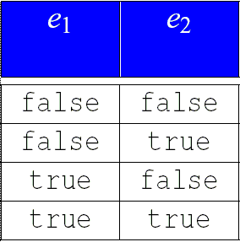
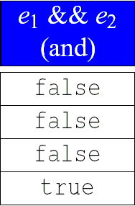
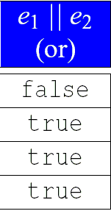
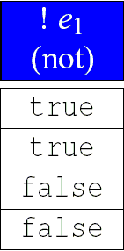
Logical Operators

